Slide 1
Classifying Letters with Neural Networks
Presented By: Alexander Aybar, Tyrell Green, Ishma’il Scott, Talaya Sherdon

Slide 2




Group Members
Alexander Aybar
Junior
Mechatronics Engineering
Tyrell Green
Sophomore
Electrical Engineering
Ishma’il Scott
Junior
Electrical Engineering
Talaya Sherdon
Sophomore
Industrial Engineering

Slide 3
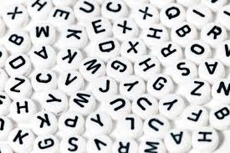
Introduction
Letters are everywhere
Documents
Handwritten letters
Photos

Slide 4

Objective
Create a model that can classify different letters in images to help with converting physical lettering into data

Slide 5

Affecting Communities
Allows better reading
Helps teachers grade assignment
Verification
Translator

Slide 6
Phase 1
Receive and Upload data
Analyze and convert
Make last column target
Show 16x8 image

Slide 7
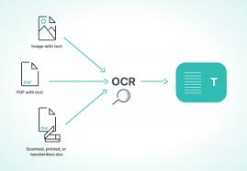
Optical Character Recognition
Identification of printed characters using photoelectric devices and computer software
Received an OCR file
Converted into Dataframe
Notes:
Contained the train data and test data
No need for exploratory data analysis because data was clean

Slide 8
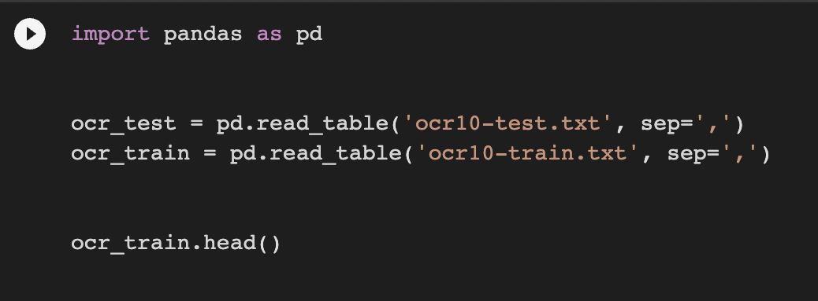
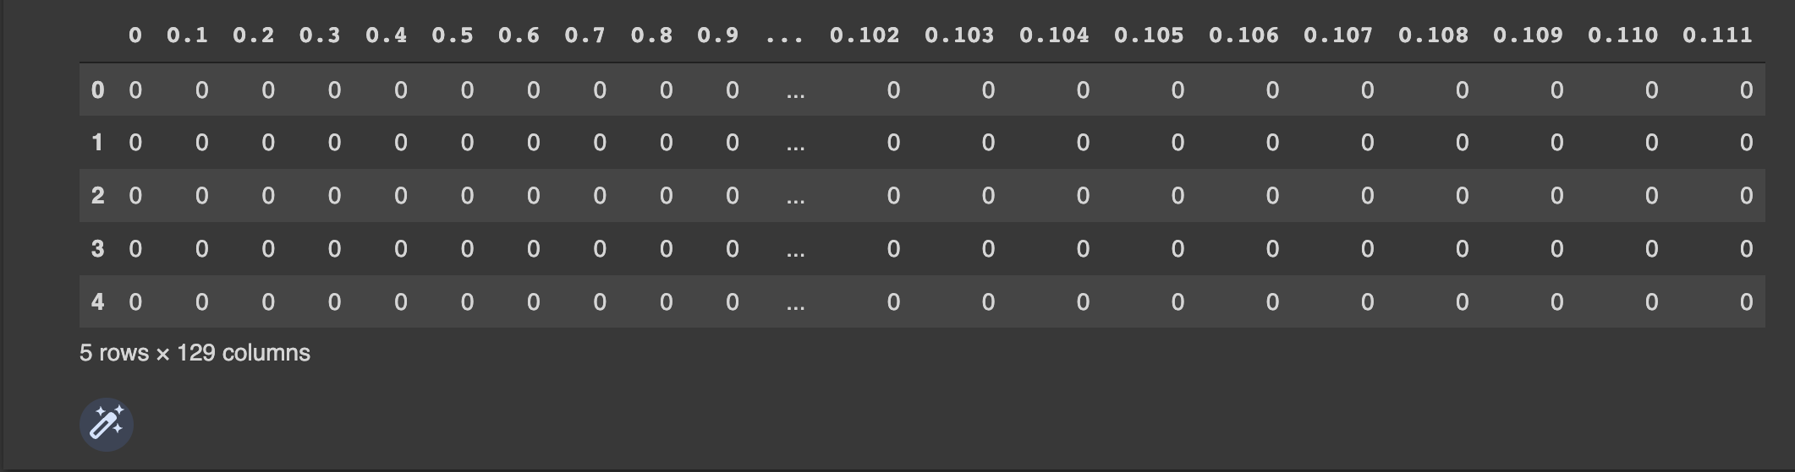
Data Frame
Creates two tables
Creates commas between numbers
Displays the data

Slide 9
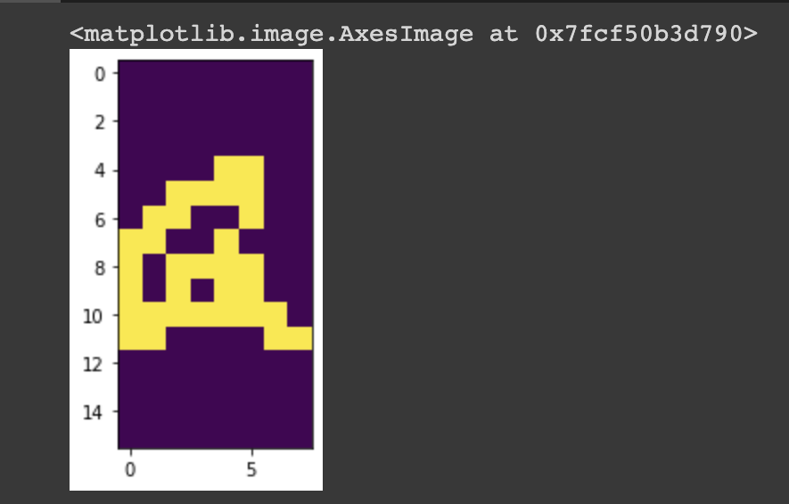
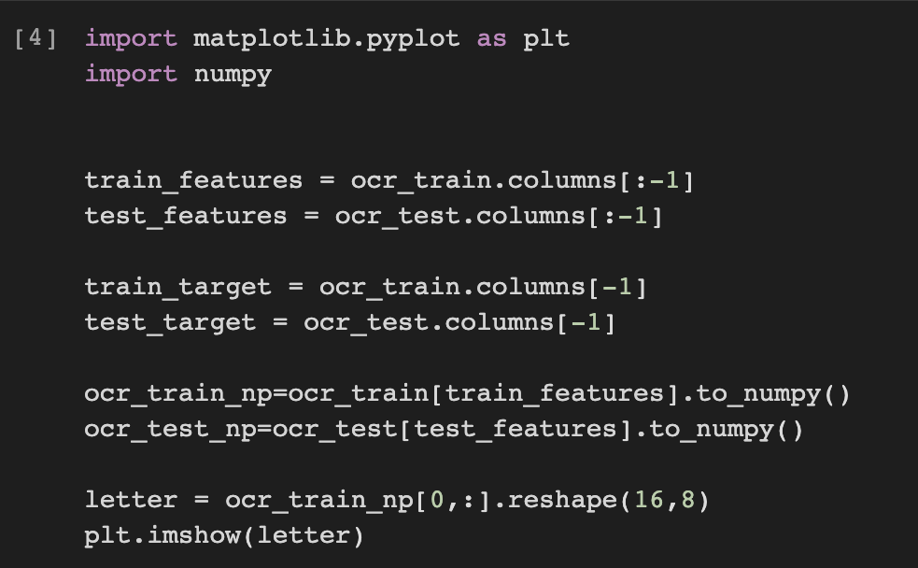
Visualization
Define the features and target
Remove last column from data set
NumPy converts train and test data
Matplotlib plots grayscale image
Notes:
NumPy and Matplotlib are libraries
Grayscale -value of each pixel only has only one of two colors
Hard to recognize because it would take too much memory (more pixels=more memory)

Slide 10
Phase 2
Create a multinomial Naïve Bayes model
Train the model
Calculate the confusion matrix and display
Classification Report
Notes:
Naïve bayes model; straightforward and fast classification algorithm suited for large chunks of data

Slide 11
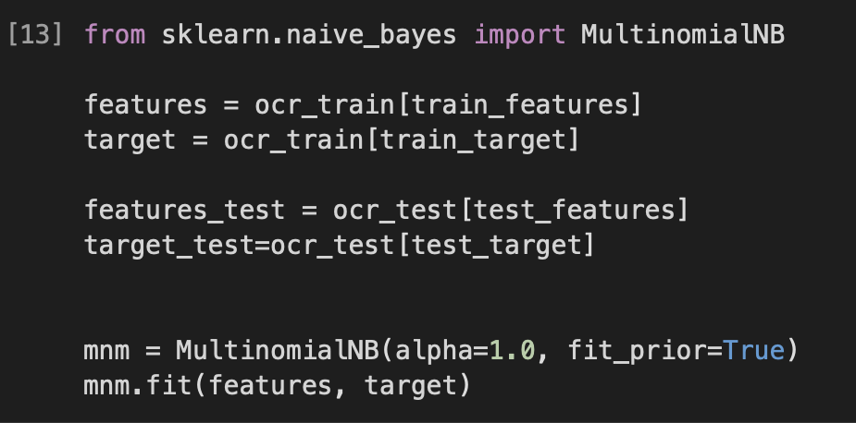
MultinomialNB
Used Naïve Bayes classifier to create our neural network
Algorithm imported through library
Used OCR training data for the input of the features and the target
Notes:
Naïve bayes classifier as mnm and called features and the target into the naïve bayes classifier

Slide 12
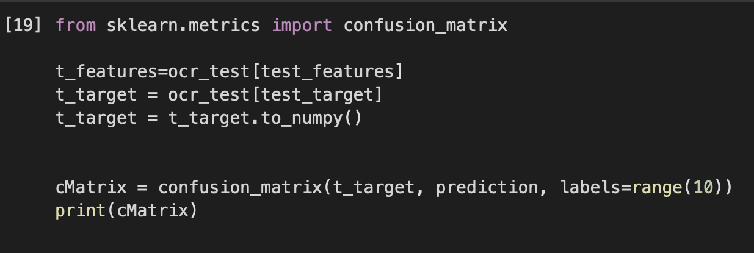
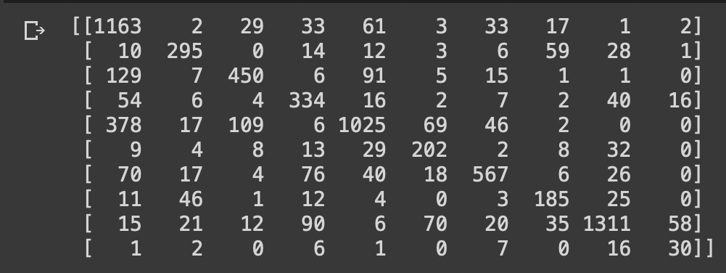
Confusion Matrix
Useful machine learning tool
Data for recall, precision, accuracy, and AUC-ROC curve
Notes:
Confusion matrix is showing the amount of error and evaluating the behavior and understanding the effectiveness of a binary pr categorical classifier

Slide 13
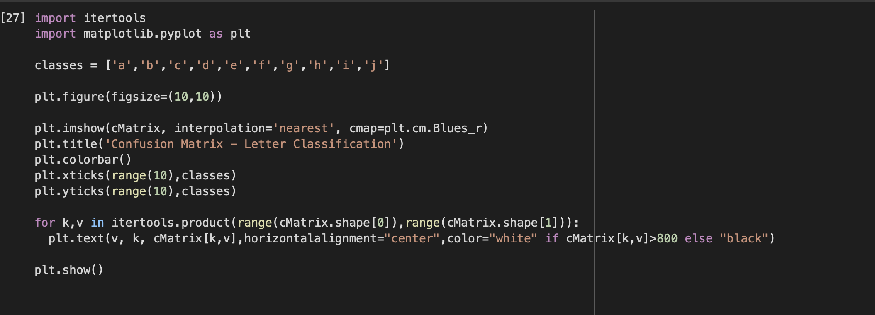
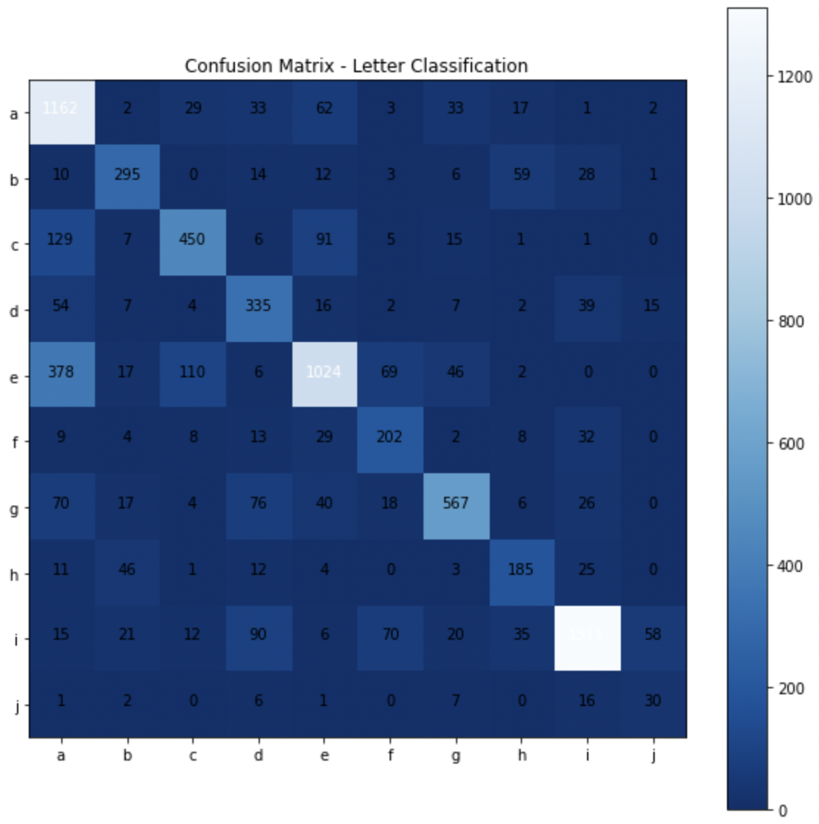
Confusion Matrix
Plotted as a heat map
Target vs predicted data
Notes:
Heat map is visualization of data

Slide 14

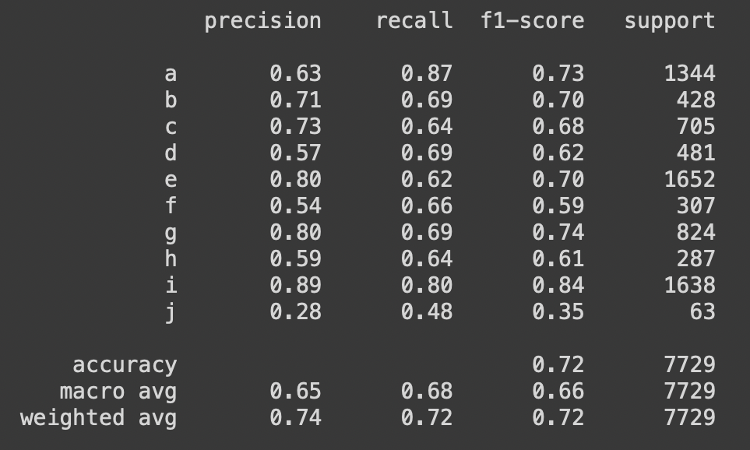
Classification Report
Shows precision, recall, f1 score and support of each Letter and the total average

Slide 15
Phase 3
Reformat the confusion matrix to better display it
Display the precision
Recall
f1-score

Slide 16
Peace and Love ☺

